Slide 1
Managing Collections
P.Sai Tejashwini
22H51A05H5

Slide 2

Introduction to Managing Collections:
Managing collections is a fundamental aspect of fullstack development.
It involves organizing and manipulating data sets efficiently across both client and server sides.
Understanding how to handle collections can greatly enhance application performance and user experience.
Notes:
Image source: https://saylordotorg.github.io/text_small-business-management-in-the-21st-century/s16-01-principles-of-management-and-o.html

Slide 3
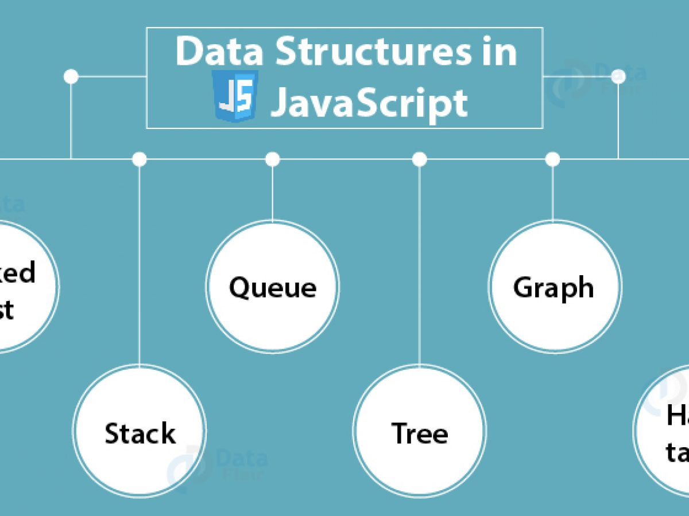
Data Structures in JavaScript:
JavaScript offers built-in data structures like Arrays and Objects for managing collections.
Advanced structures such as Maps and Sets provide enhanced functionalities for data manipulation.
Understanding these structures allows developers to write cleaner and more efficient code.
Notes:
Image source: https://gregoryboxij.blogspot.com/2021/04/39-javascript-directed-graph-data.html

Slide 4
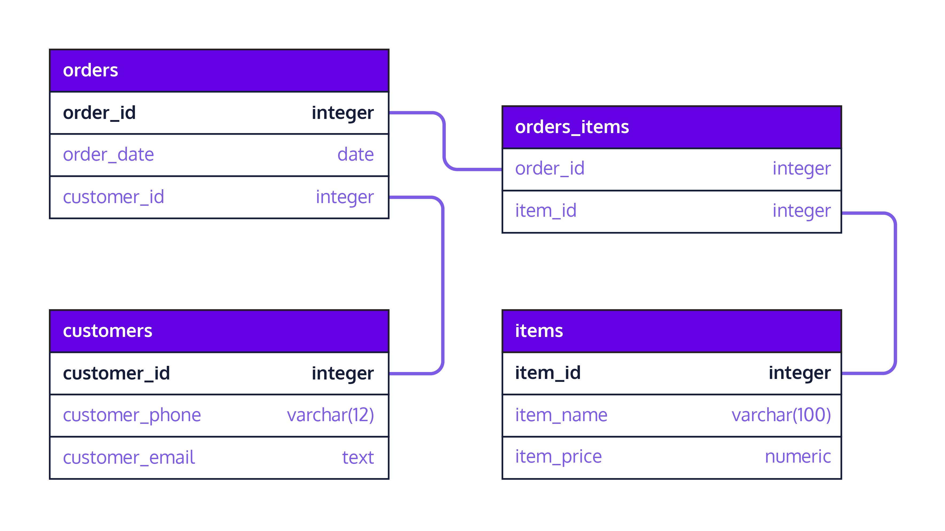
Databases and Collections:
Relational databases use tables for collections, while NoSQL databases employ collections and documents.
Each database type has its own querying methods for managing collections effectively.
Selecting the appropriate database is essential for optimizing data retrieval and storage.
Notes:
Image source: https://codeplater.hashnode.dev/an-introductory-guide-to-schema-design-and-data-organization-in-relational-and-document-based-databases

Slide 5
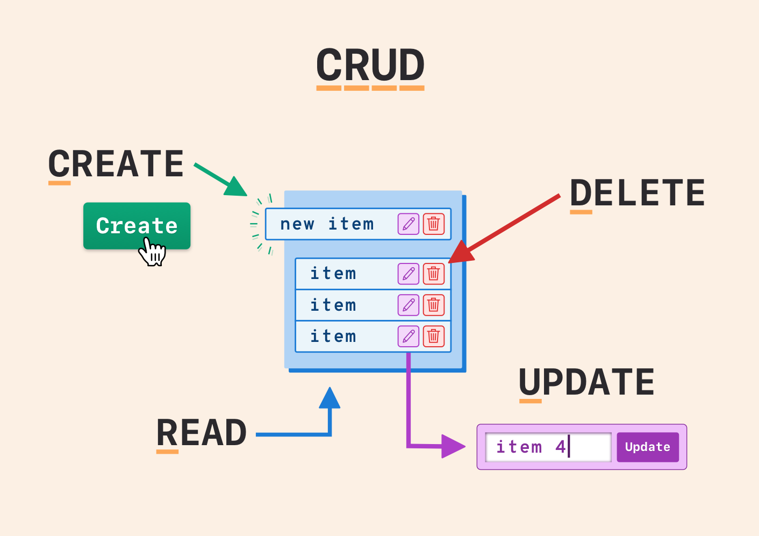
CRUD Operations
CRUD stands for Create, Read, Update, and Delete, which are the four basic operations for managing collections.
Implementing these operations correctly ensures that data is handled efficiently and accurately.
Understanding how to perform CRUD operations is essential for backend development.
Notes:
Image source: https://mavink.com/explore/Crud-Diagram

Slide 6
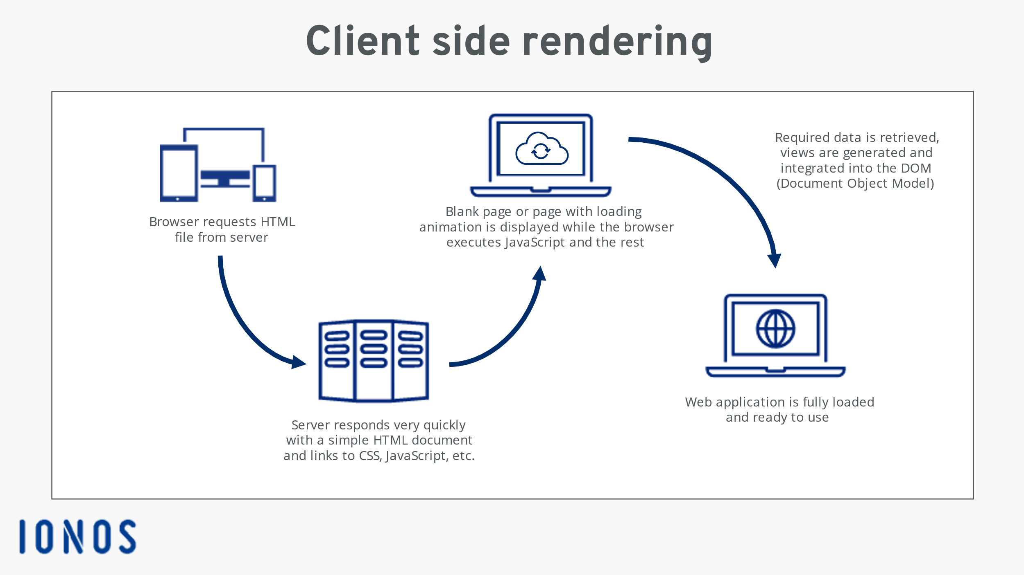
Client-Side Collection Management:
Client-side frameworks like React and Vue.js provide tools for managing collections in the UI.
State management libraries, such as Redux or Vuex, help streamline data flow and updates.
Effective client-side management enhances responsiveness and provides a better user experience.
Notes:
Image source: https://www.ionos.com/digitalguide/websites/web-development/server-side-and-client-side-scripting-the-differences/

Slide 7
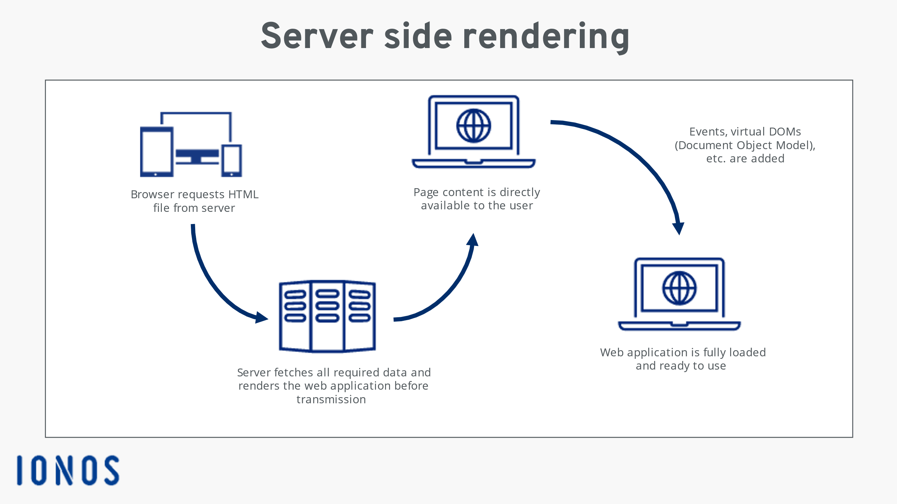
Server-Side Collection Management:
On the server side, frameworks like Express.js facilitate handling collections through APIs.
Utilizing ORMs (Object-Relational Mappers) can simplify database interactions and collection management.
Proper server-side management ensures data integrity and security across applications.
Notes:
Image source: https://www.ionos.com/digitalguide/websites/web-development/server-side-and-client-side-scripting-the-differences/

Slide 8
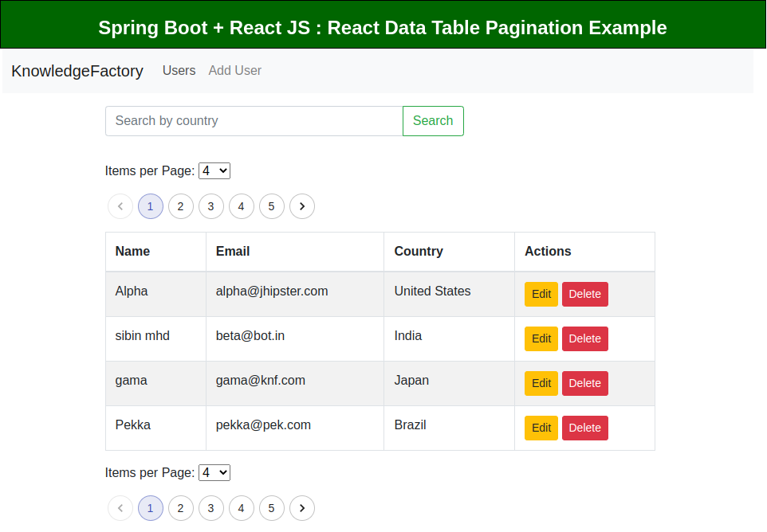
Pagination and Filtering:
Managing large collections requires techniques like pagination to improve load times and usability.
Implementing filtering allows users to find specific data quickly and efficiently.
Both techniques enhance the performance of applications and user satisfaction.
Notes:
Image source: https://www.knowledgefactory.net/2022/06/spring-boot-reactjs-data-table-pagination.html

Slide 9
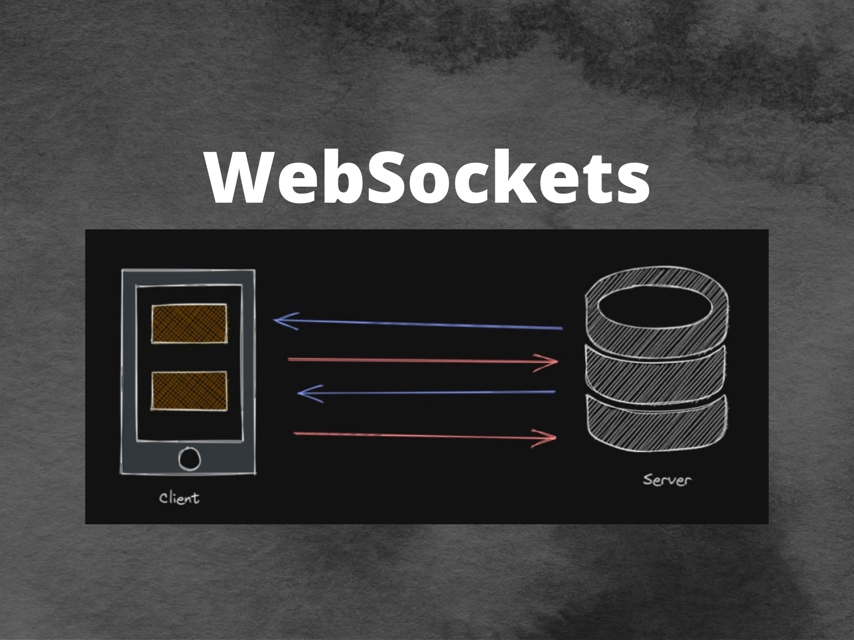
Real-Time Collection Updates:
Technologies like WebSockets enable real-time updates to collections for dynamic applications.
This capability is essential for collaborative applications where multiple users interact simultaneously.
Implementing real-time features can significantly enhance user engagement and application responsiveness.
Notes:
Image source: https://www.gavant.com/library/using-websockets-for-real-time-updates-in-a-serverless-web-application/

Slide 10
Conclusion:
Effective management of collections is crucial for successful fullstack development.Adopting best practices, such as proper data structuring and efficient CRUD operations, can enhance application performance.
Notes:
Image source: http://intellspot.com/data-management-best-practices/

Slide 11
THANK YOU

